Slide 1
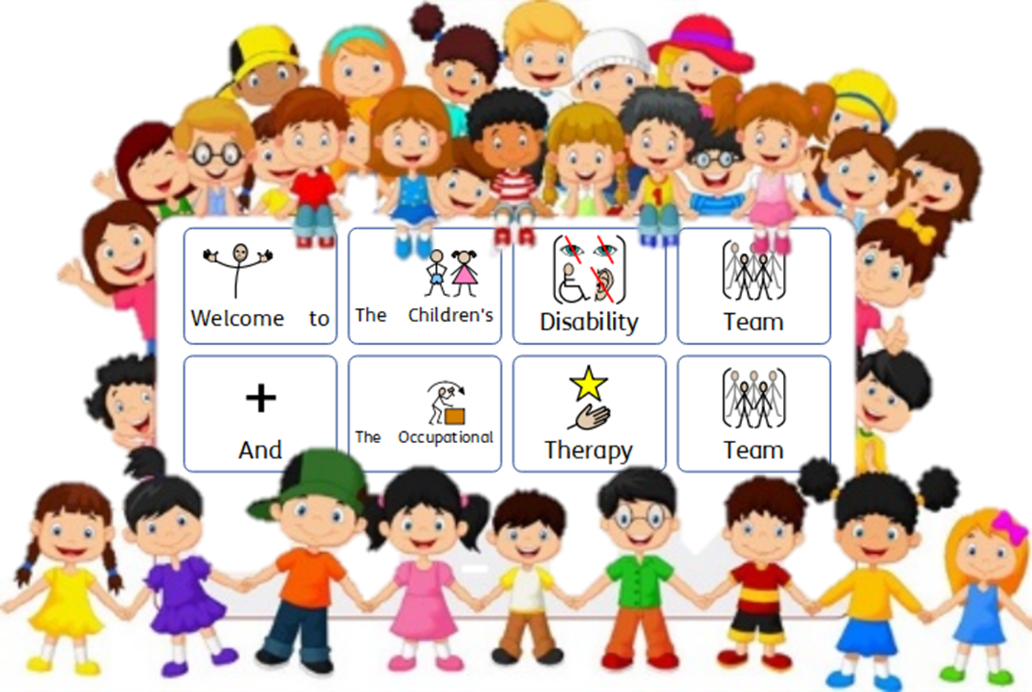

Slide 2
Structure
Team One
Agency Team Manager –
Vacant
Lesley Burton – Team Co
Kirsty Moss – G9 PT
Julie Whincup – G9 -FT
Teresa Coton G9 –PT
Eleanor Dawson – ASYE G8 FT
Michelle Williams ASYE -PT
Steve Lumb G8 FT Agency David Lyons –G8 - Agency FT
Louise Bird FP PT
Team Two
Tracy Metcalf-Team Manager
Angie Plummer Team Co
Alan Stainforth G9 -FT
Lee Marshal G9 - PT
Liz Liversidge G9 -PT
Amy McStravick G8 -FT
Jenni Allan G8 -FT
Nikita Welsh – ASYE FT
Leanne Watson Agency SW
Hellen Urben FP
HOS
Niki Heffernan
Group Manager
Karen Lamb

Slide 3
HOS – Niki Heffernan
Group Manager – Karen Lamb
X2 Team Managers – Tracy Metcalf
vacant – awaiting approval for Internal TM Transfer request
Louise Birtchnell – Occupational Therapist - FT
Jacqui Twomey - Occupational Therapist – 3 days
Geraldine Owens – Occupational Therapist - 13 hrs
Dan Thirkettle – Occupational Therapy Assistant – 4 days
Lauren Hoyle – Admin Support for OT team - FT

Slide 4
Continuing Health Care Nurses
Paediatric Consultants/Community Paediatric Consultants
Various expert consultants at HRI, Sheffield General Hospital, Leeds General Hospital and Great Ormond Street
Neurologists/Epilepsy Nurses /Dieticians
CAMHS/ Sexually Harmful Behaviour Forensic Psychologist
Special Educational provision locally and out of County
Health Visitors/IPASS/ KIDS Practitioners/ Speech and Language Therapists (SALT)
Sunshine House/Lime Tree Court/Kinloss/Martin House Hospice/LAFFS EH
Physiotherapists/ Occupational Therapists (LA and Health)
Agency Foster SW/ Adult Social Care /IMCA’s
Housing/ surveyors /wheelchair services

Slide 5
Diagnosed disabilities
Children with gastrostomies and tracheostomy
Children with diagnosed ASD/Aspergers
Children with chromosome deletion and associated disabilities
Children with varied severe epilepsy
Children with Life Limiting conditions
Children with complex health needs
Children at end of life

Slide 6
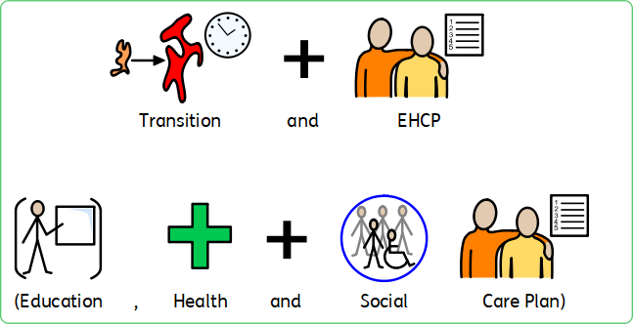
Transition Planning is started from age of 14 yrs and involves a referral being made to adults social care.
Social Workers complete section H for all annual EHCP reviews.
Adults SW should then be identified to attend the next annual EHCP. (This is not necessarily an allocated SW at this stage)
Transition planning continues thereafter and can involve the following agencies and professionals:
Adult Social Care/ assessments
Adult Community Team for Learning Disability
Leaving Care Team
IMCA – Independent Mental Capacity Assessor
Best Interest Meetings
Capacity Assessments
Planning Meetings
Adult specialist provision
DOLLS / LSP Liberty Safeguarding Protects
We also attend Preparation for Adulthood Operational Meetings - monthly

Slide 7
We have a Family Practitioner who facilitates Sleep work.
A Family Practitioner is a facilitator of the Stepping Stones training.
A Family Practitioner will undertake direct work with creative communication tools
We have access to a Communication Inprint 3 to support creative ways to communicate with non verbal children
Mind of My Own App (Express) is being promoted
Kids Advocacy Service is accessed
Nyas Advocacy Service is also accessed

Slide 8
Children and Families Disability Team have since July 2020 been more recognised supporting the voice of children with Disabilities and complex health needs being heard and children being more visible.
We are working with Localities Group Managers and Team Managers developing more joint working together for Children with Disabilities
We are actively engaging in Transfer meetings with Access and Assessment
We are actively engaging in Transfer Meetings with Localities
We are more integrated in working together across services for Children with disabilities and complex needs
We have identified Social workers within the team to offer support, advice and guidance to services for other service areas
We are supporting with some joint working in preparing children for transition from other service areas to CFDT.
We are also actively engaging in various meetings with the Improvement Board – Performance Improvement, Performance Panel Task Group, Voice and Influence, Mind of my Own, SOS Project Group, Preparation for Adulthood Working Group, Parent Carer Listening event, SEND etc

Slide 9
Since July 20 there has been significant increase of referrals and children being progressed to Disability Team for assessment from Early Help.
There has also been a lot of work undertaken to ensure children with disabilities across ALL service areas are transferred to CFDT where appropriate to ensure needs and support is met.
However where children with disabilities remain within other service areas we offer support and advice to including to areas such as Post Adoption Team, Fostering, ILAC, Access and Assessment and Localities.
We have provided direct support with Social Workers from other service areas.
We have attended Strategy Meetings for Children with disabilities as appropriate to ensure support and advice considered also individual needs.
We have allocated SW’s at point of Initial Child Protection Conferences and initial care proceedings for children with additional and complex needs and Learning Disabilities to ensure better support, understanding of need and planning can be considered.
We have identified Link Social Workers for all Special Educational Provisions to access support and advice.
We are developing a piece of work with Anlaby Suite in relation to supporting the communication for children with additional, complex health and physical needs to prepare for medicals as part of Sec 47.
There also continues to be a significant increase in requests from families for a statutory Assessments

Slide 10
We are working to develop more collaborative working with the following to name a few initially:
Parent / Carers Forum
SENDIASS
Neurodiversity
Adults - Preparation for Adulthood
SEND Transport
SEND Team – to support with EHCP’s
Hull and ERYC – CHSWG (childrens hearing Services Working Group
Early Help
LAFSS

Slide 11
So what do our OT’s offer
The Occupational Therapy Team provides an assessment and provision of equipment, adaptations, rehousing options to meet the child/young person’s and caregivers needs.
They undertake assessments and approvals of Blue Badge applications.
So What is Our Occupational Therapy Teams Aims
We aim to ensure that a child/young person is able to reach their true potential.
We aim to ensure the care giver is able to care for the child/young person safely within their place of residence.

Slide 12
There are also other forms of assessments undertaken through other providers such as:
• Assessment and provision of wheelchairs
• Assessment and provision of play equipment
• Sensory processing assessments
• Rehabilitation and habituation programmes
• Behavioural programmes
• Assessments within educational settings
• Assessment and provision of orthotics
• Risk assessments for other professionals equipment prescriptions

Slide 13
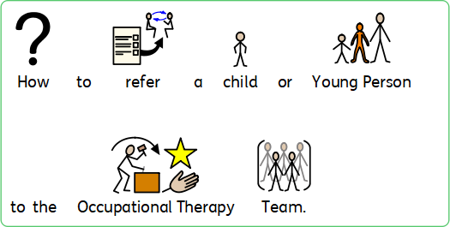
If a child is already known to Children’s and Young Peoples Services contact Lauren Hoyle who will send an internal OT referral form to complete and return to Lauren. Please provide as much information as possible about the child/young person and the challenges they face that you would like OT to assess.
If these are prescriptive they may raise expectations as this referral is a request for a specialist OT assessment which will reflect need to determine support/equipment/adaptations.
Please ensure that the weight, height of a child/young person, their GP and NHS number are on the referral as we are unable to proceed with the assessment without this vital information.
Referrals that are not fully completed will be returned to the referrer.
Referrals for children and young people who are not known to Children and Young Peoples services are to be referred by parents/carers, other agencies/professionals through EHASH to request an assessment from OT.

Slide 14
The OT team receives a very high number of referrals which has also seen a significant increase during COVID 19 and at present there is a waiting list of children and young people waiting for an assessment. Due to this high demand we need to prioritise those most in need. Therefore priority is given to:
Hospital discharge
To prevent need for emergency respite
Moving and handling assessments for essential activities of daily living
End of life care
Children and Young people at high risk of injury.

Slide 15
Children and Families Disability Team OT’s also progress/approve or decline Blue Badge requests/applications.
All applications for blue badges need to be completed online. Caregivers are able to apply via C360 website on the Hull City Council Internet Page.
If caregivers do not have access to the internet they can call into their local library were they will be assisted to complete the online application and upload the relevant paperwork required.
Applications that do not meet the criteria for automatic approval will be reviewed by Dan Thirkettle, Family Practitioner OTA who will ensure all paperwork has been attached so that a decision can be made regarding approval/refusal.

Slide 16
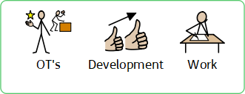
There are times when OT needs to provide equipment and adaptations that are classed as a restraint as it restricts the movement of the child/young person.
The OT team are currently working with a number of significant agencies including police and fire services to develop an agreed pathway and paperwork to ensure there is a robust process for the provision of this type of equipment and adaptations. This will then go for senior managers approval.
There has been a significant increase in referrals for children with a diagnosis of Autism and/or exhibit behaviours that challenge. The OT Team are developing a resource of options/solutions and evidence of best practice to ensure the needs of these children can be met.

Slide 17
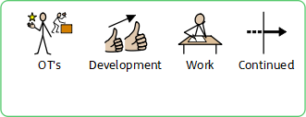
Lauren Hoyle, Admin Modern Apprentice is developing a child and young person feedback form using the communication In Print3 as demonstrated throughout this presentation.
The review of the adaptations and equipment criteria is ongoing with the OT Team working with commissioners and housing to ensure the service is meeting the changing needs of children and young people.

Slide 18
KIDS - 467540
SENDIAS (Special Educational Needs and Disabilities Advice and Support Service) - 467540
HRI - 875875
Community Paediatric OT Service – 692929
Sensory Processing Service – The Neurodiversity Team, Walker Street Centre, Hull.
NRS – Equipment -
Wheelchair Service – Reed Street, Hull – 03448936375

Slide 19
Ganton Special Educational Provision - 564646
Tweendykes Special Educational Provision - 826508
Northcott Special Educational Provision - 825311
Limetree Court – 612513
Fredrick Holmes Special Educational Provision - 804766
Kinloss - 833101
Sunshine House - 976841
Martin House Hospice – 01937 845045

