Slide 1
Why am I at home?
A Social Story by Megan

Slide 2
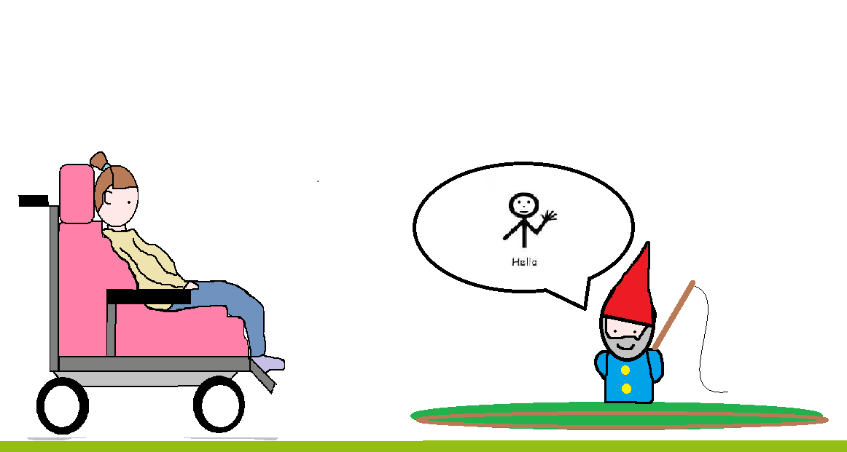
Why am I at home? The only person I’ve seen for weeks is the garden gnome…

Slide 3
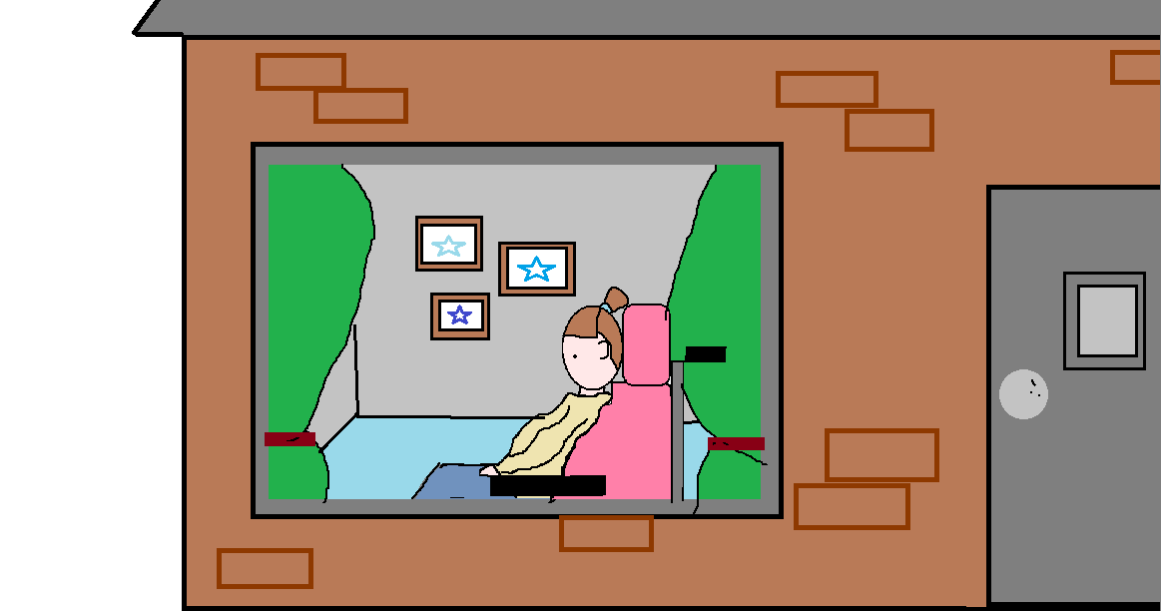
Mum, Dad, Oliver and me, have all been here for days All everyone keeps saying is how important it is that everyone stays.

Slide 4
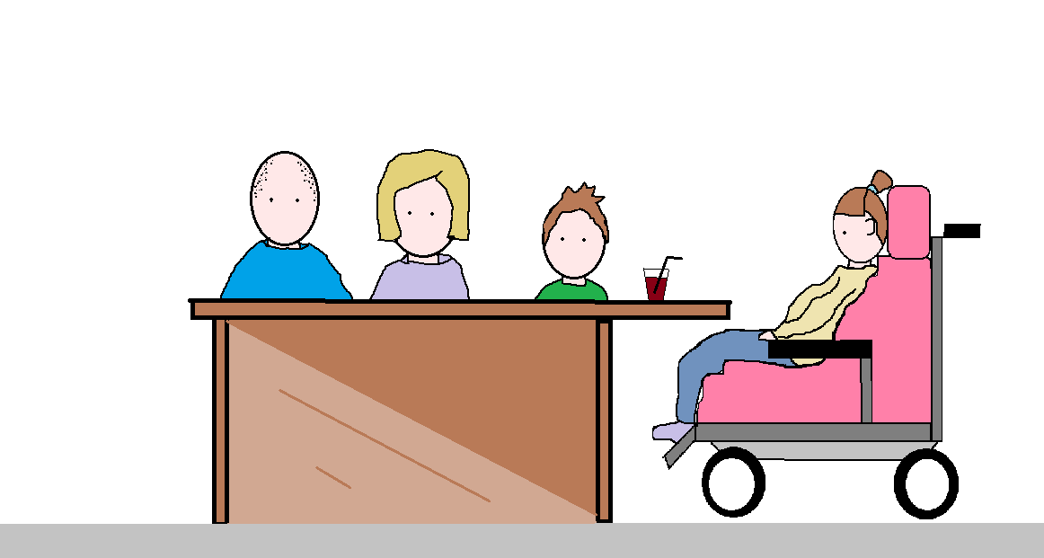
After tea one night, Mum and Dad sat us down Oliver came too, they said we were on Lockdown…

Slide 5
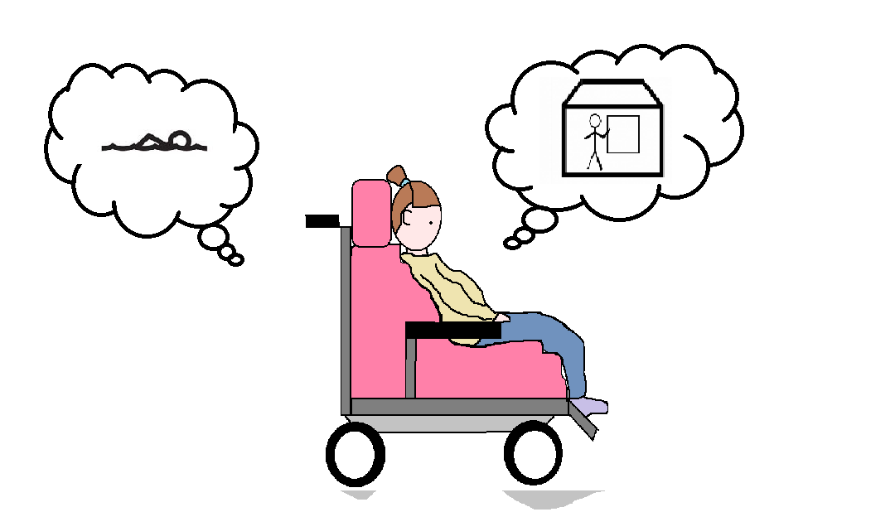
What does this mean? Can I go to school? I don’t know what I’ll do if I can’t use the Hydro pool….

Slide 6
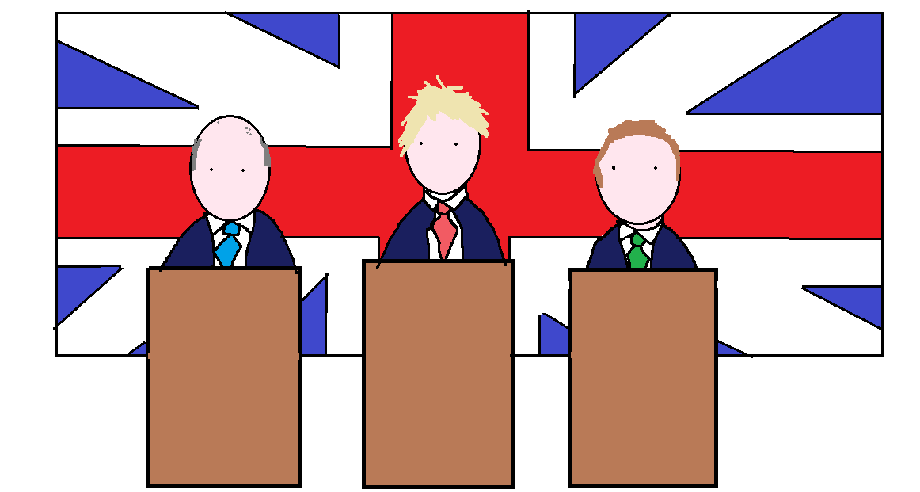
“No School, No Friends, No Visitors!” Said the men on the telly. They were the Ministers.

Slide 7
Why was this happening? What was this word everyone was babbling?
Coronavirus
Covid-19
The Virus

Slide 8
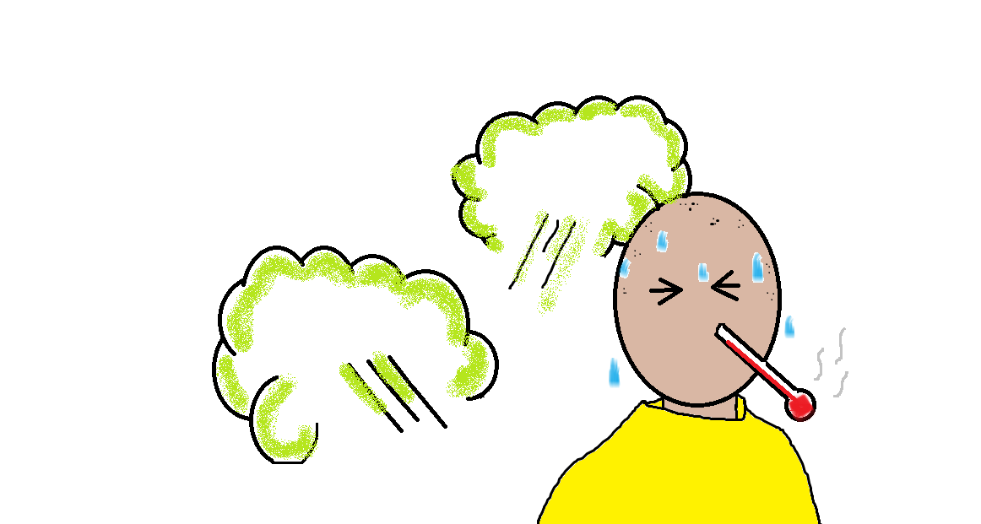
Dad said there was a nasty Flu going around. He said it would spread superfast on the playground.

Slide 9
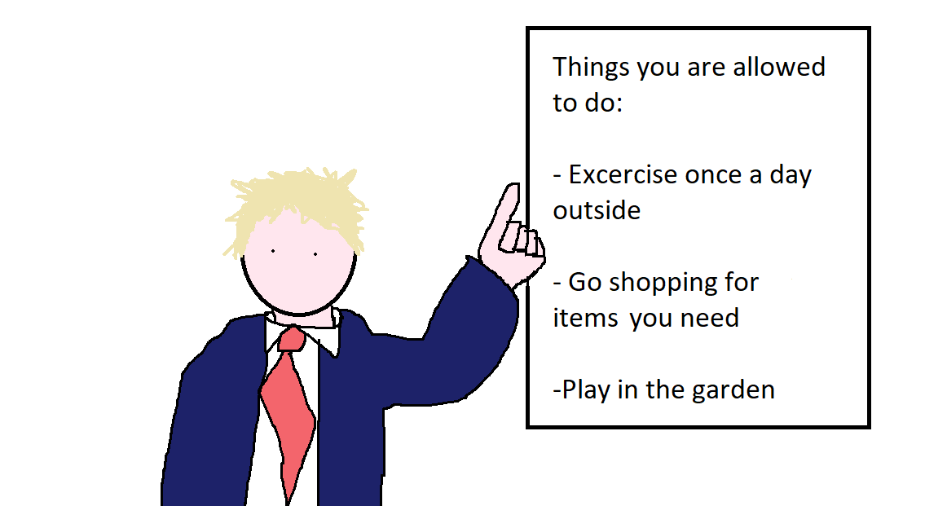
It’s safe for everyone to be at home for now ..but there are certain things the Ministers allow…

Slide 10
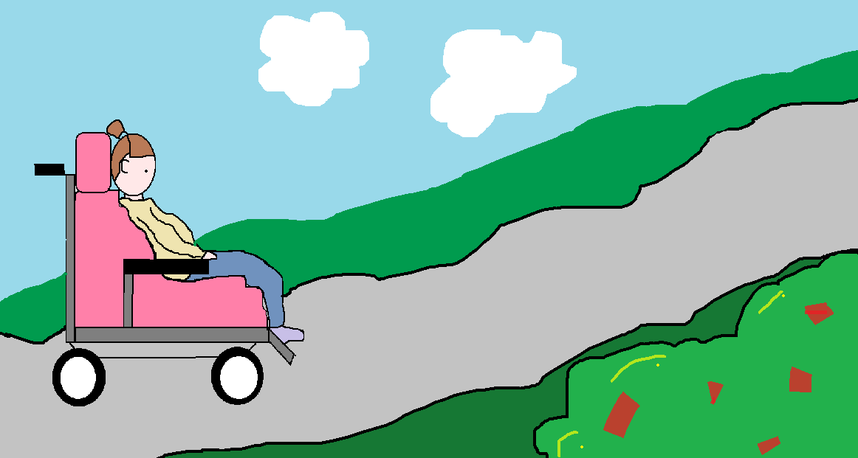
One walk or a bit of outside exercise a day For me, it’s safer to wait a bit longer before I get out of that doorway.

Slide 11
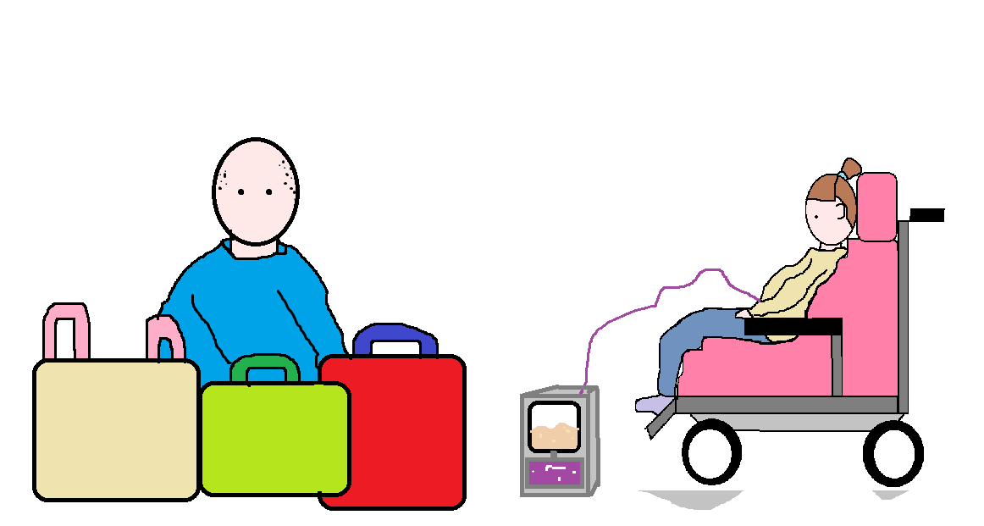
“The shops and Chemists are open for bits you need…” “Which is good!” Said Mum “As we need to get Polly’s feed.”

Slide 12
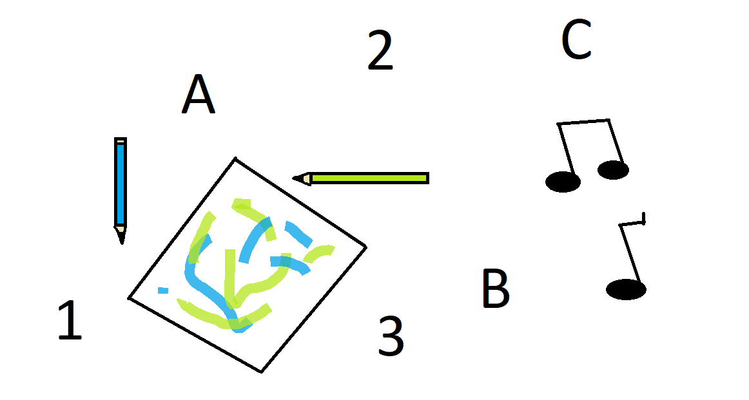
Dad said “Staying at home may seem boring, but there’s lots that can be done.. You can play games, laugh and learn with me and your Mum!”

Slide 13
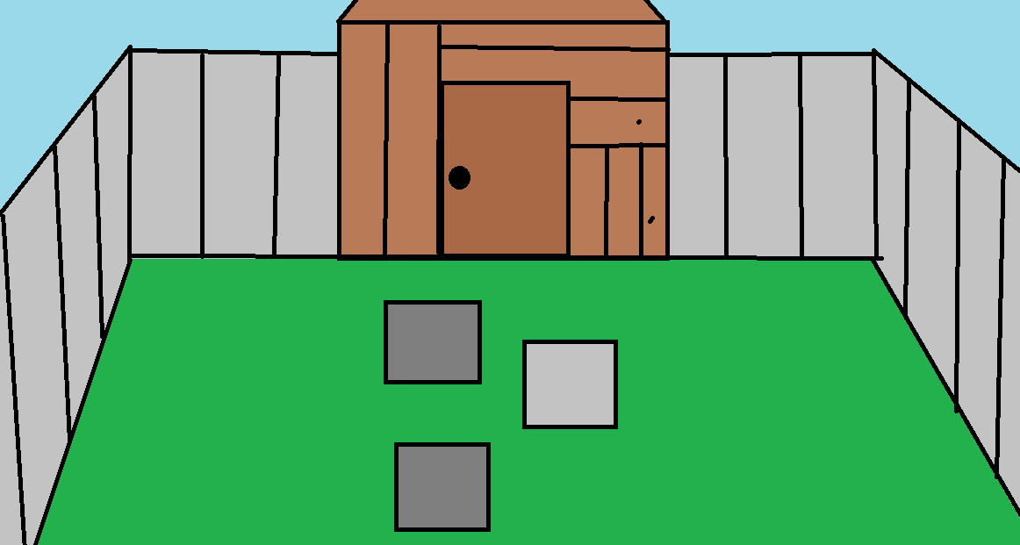
‘’Aren’t you going to work Dad?” Oliver said “I’m not going out Oliver, I’ve set up a home office, in the shed.”

Slide 14
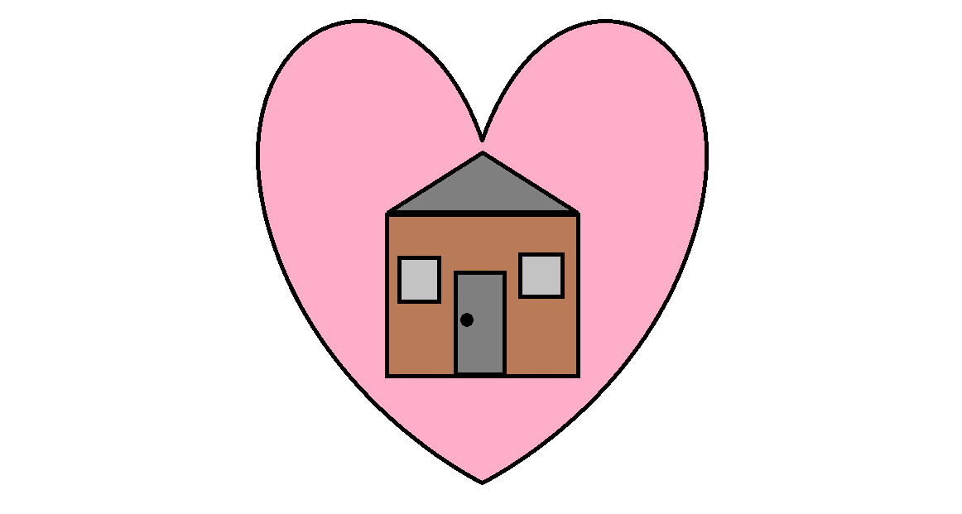
While we are all at home we are safe.

