Slide 1
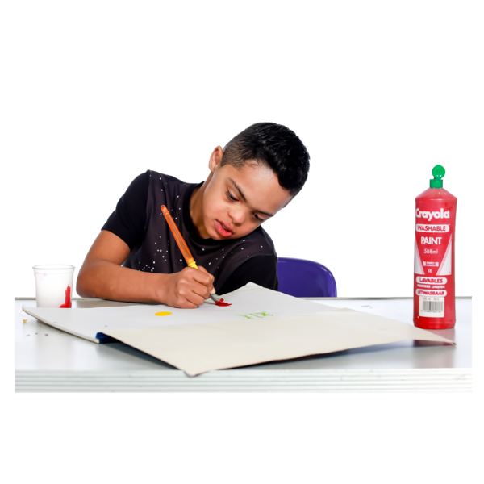
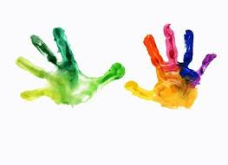
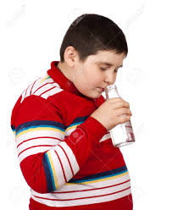
Sensory activities for home
There are lots of things that we can do at home that can be perfect for people with sensory needs of all ages…
Playing with bubbles
This can be;
Blowing Bubbles outside
Being in a bath full of bubbles
Playing with bubbles in the sink
Playing with bubbles in a pool in the garden
Stay at home
Only go outside for food, health reasons or work (but only if you cannot work from home)
If you go out, stay 2 metres (6ft) away from other people at all times
Wash your hands as soon as you get home
Do not meet others, even friends or family. You can spread the virus even if you don’t have symptoms.
Read more about what you can and cannot do
Finger painting
Splashing and sploshing in paint can be fun for everyone.
Painting doesn’t just have to be just on paper either.
Smelling bottles
Enjoy experiencing different smells. Trap smells on tissues inside bottles and enjoy.

Slide 2
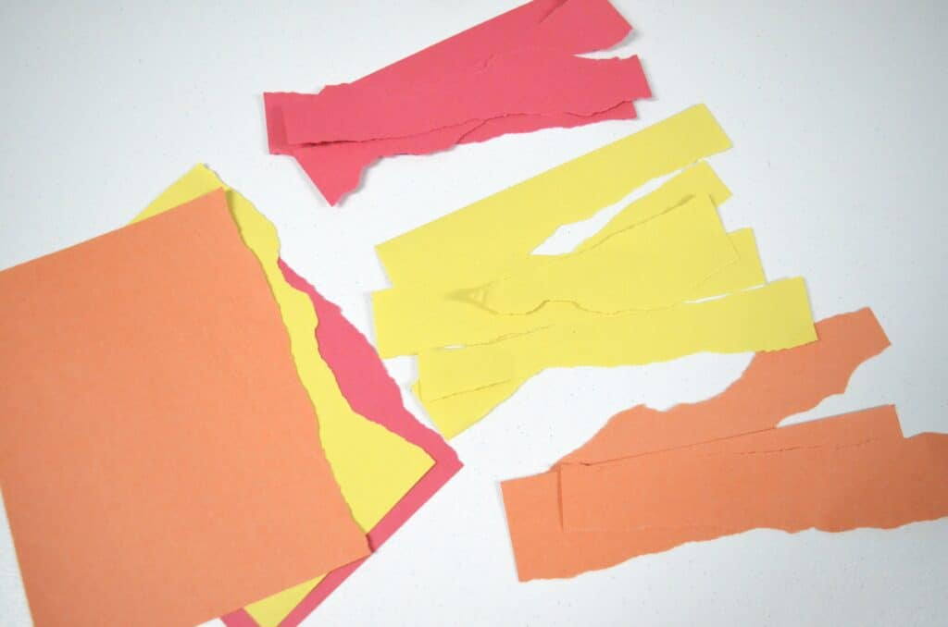
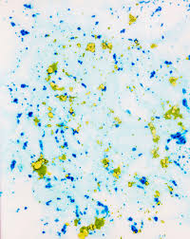
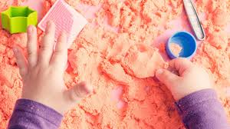
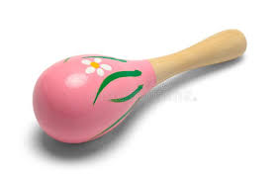
Ripping paper
Tearing and ripping up paper can be a comforting thing for children and adults. Mixing up colours can create different effects.
Colour mixing
This can be done with paint, bubbles, water with food colouring, sand, salt dough and chalks in the garden! Create different patterns and pictures.
.
Messy play
Food, sand, water, paint, playdough, mud or bath soaps. Throw them about a bit and have fun enjoying textures.
Sound making
Rattle a Pringles tube, a plastic bottle or bang your pots and pans. Create sweet music! Make your own band!
.

Slide 3
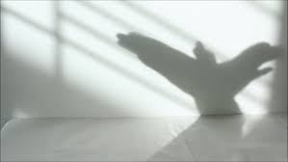
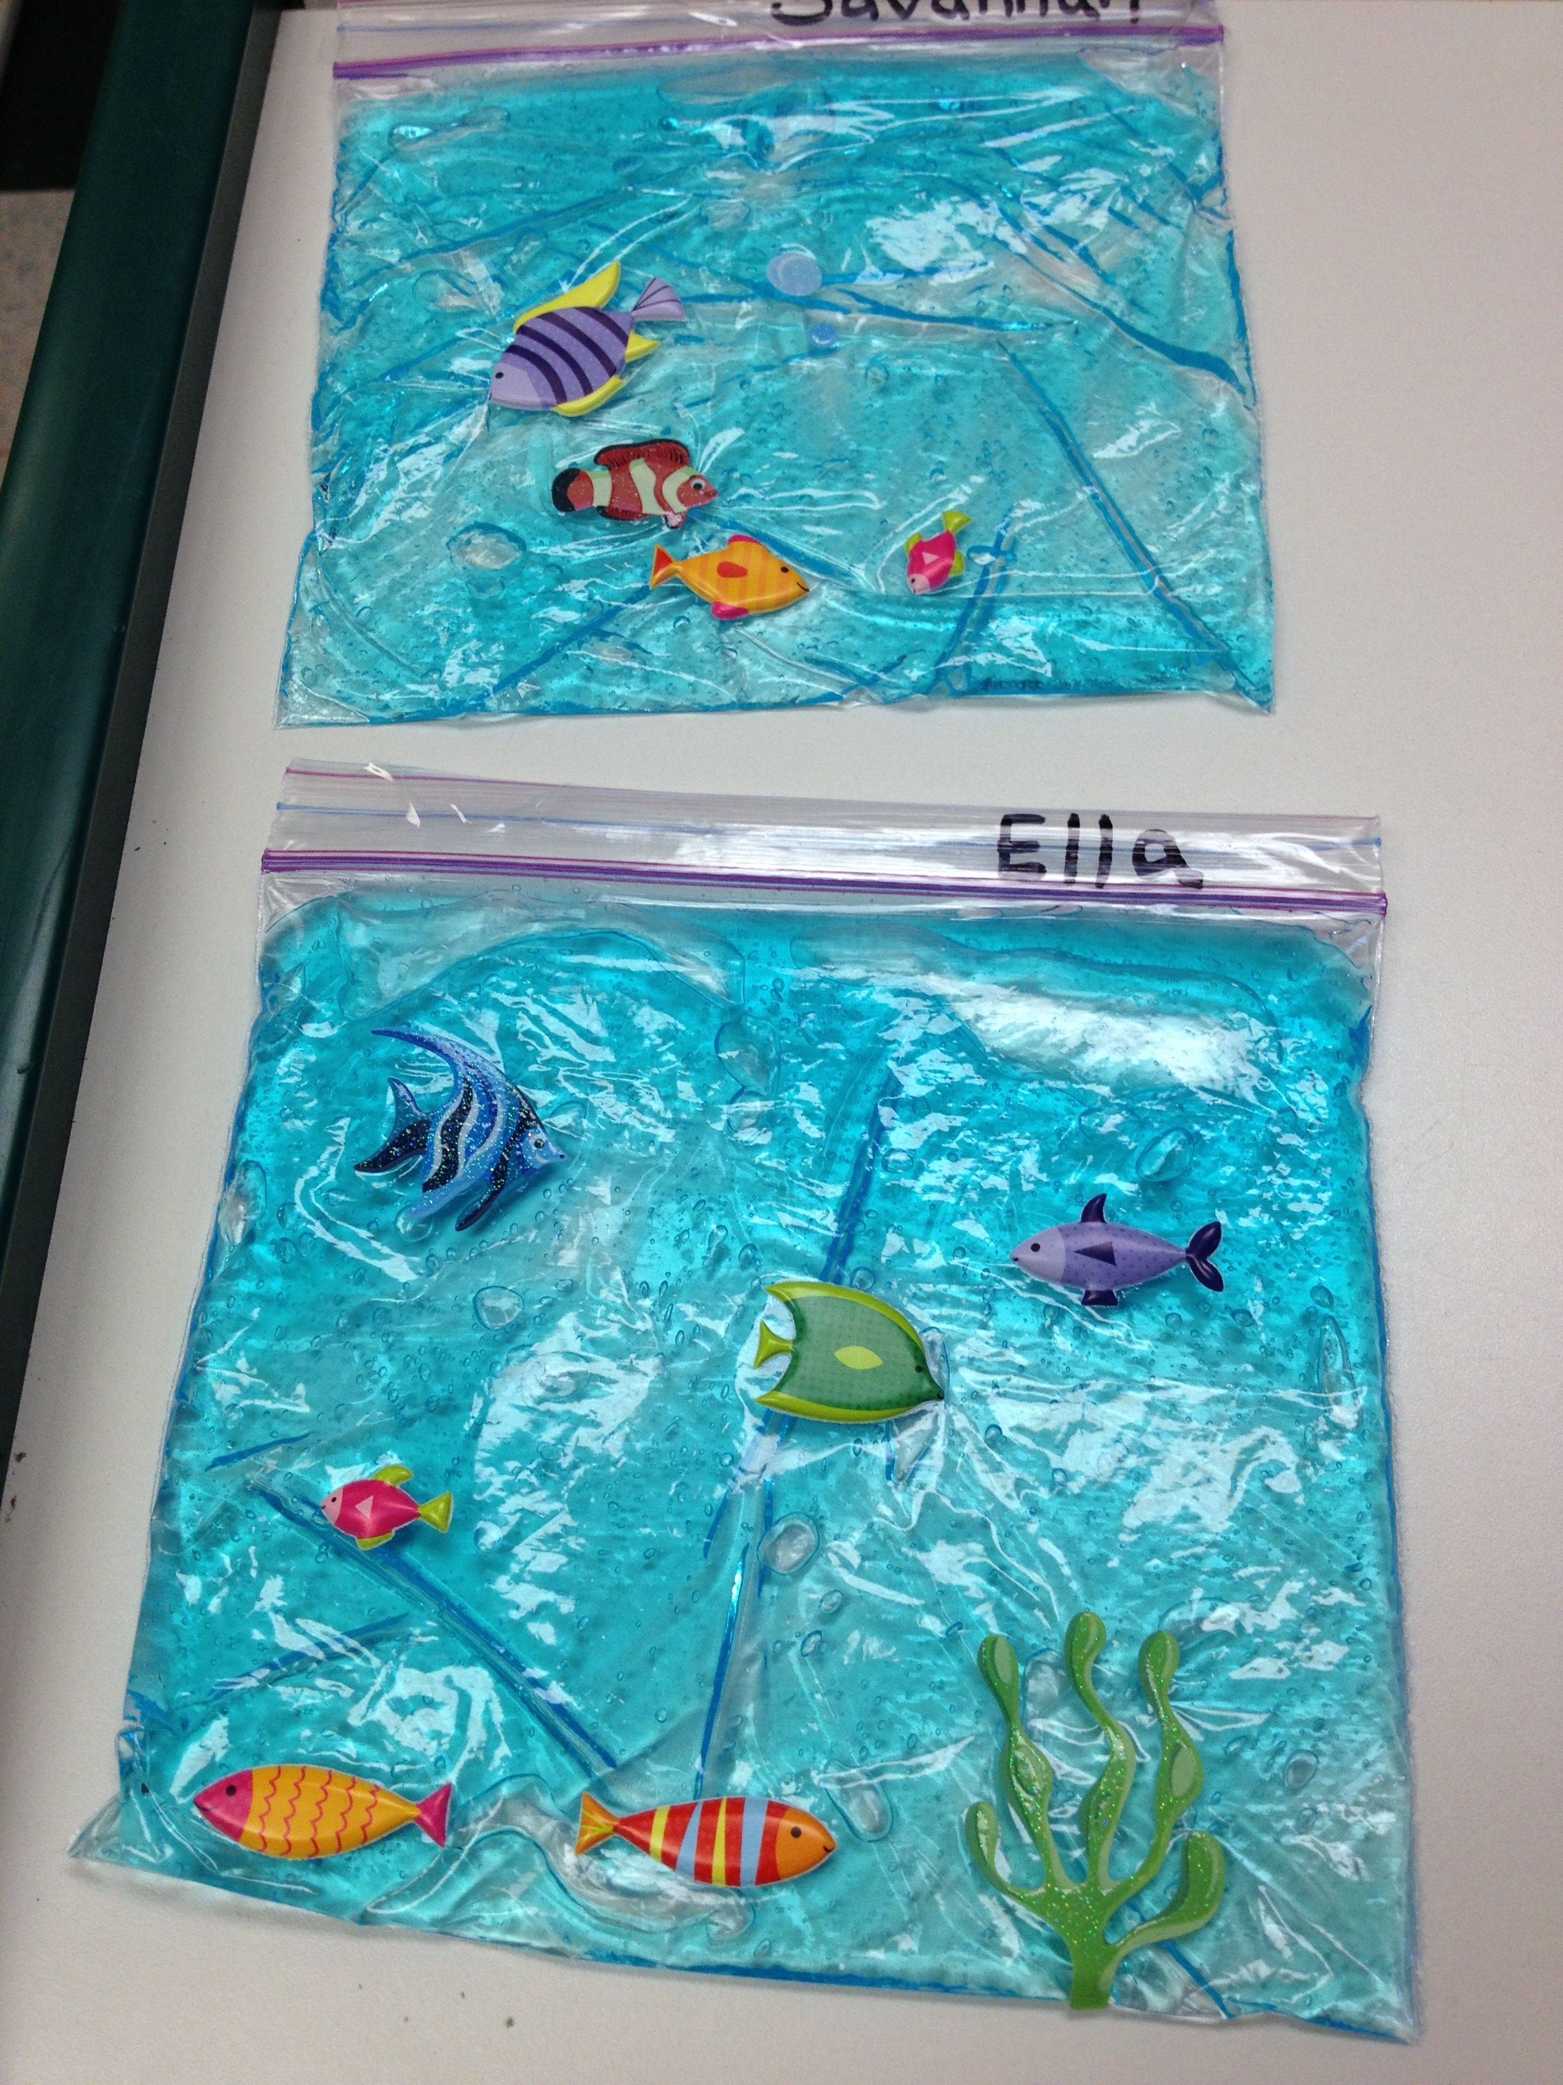
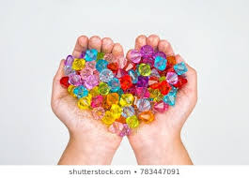
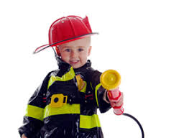
Shadow play
Make patterns and shapes with objects to create shadows. Perfect for people who can see lights and shapes.
Sensory bags and bottles
Fill a bag or bottle with some shower gel, washing up liquid or hair gel – add objects or glitter to make super fun patterns. Fasten tightly!
.
Texture play
Enjoy experiencing textures with beads, buttons or different materials.
Imagination Play
Let your imagination run wild, dress up and play games. Role play a bit!
Be the police man, or shop keeper of your dreams.

